Slide 1
Introduction to Testing in JavaScript with Mocha and Chai

Slide 2
Resources
Jani Hartikainen's book and articles were extremely helpful in creating this presentation.
Unit Test Your JavaScript with Mocha and Chai
What Are Unit Testing, Integration Testing, and Function Testing
What’s the difference between Unit Testing, TDD and BDD?
How to Structure Your Tests

Slide 3
What is the point of unit testing?
Unit tests are written to automatically detect problems in your code for you. Make a change, run your tests, and if anything breaks, you’ll immediately know what happened, where the problem is, and what the correct behavior should be.
This is especially helpful when you’re working with a lot of code or when a group of people are working on the same code.

Slide 4
What is a unit test
A unit test tests a function’s behavior when giving it a certain set of inputs. You call a function with certain arguments, and check that you get the expected output.

Slide 5
What is test-driven development (TDD)?
Test-Driven Development puts testing first. In some cases it can mean writing the tests for your code, before you actually write the code. The expectation is that a high percentage of the code will be tested.
TDD makes maintaining code and adding new features easier.

Slide 6
What is behavior-driven development (BDD)?
BDD is a set of best practices for writing great tests. BDD can, and should be, used together with TDD and unit testing methods.
BDD abstracts away from how the tested function is implemented and shifts focus from testing implementation to testing behavior. By using more “behavior oriented” language, it helps us focus on the fact that we’re working with behaviors, instead of specific actions in code, hopefully resulting in code that will require fewer alterations as you extend it.

Slide 7
What is Mocha
Mocha is a feature-rich JavaScript test framework running on Node.js and in the browser, making asynchronous testing simple and fun. Mocha tests run serially, allowing for flexible and accurate reporting, while mapping uncaught exceptions to the correct test cases. Hosted on GitHub.
Other testing frameworks: Jasmine, Jest, AVA, Tape
https://raygun.com/blog/javascript-unit-testing-frameworks/

Slide 8
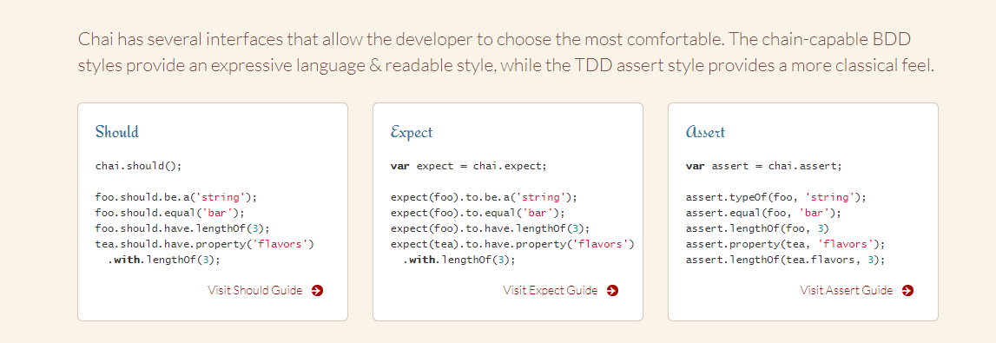
What is Chai
Chai is a BDD / TDD assertion library for node and the browser that can be delightfully paired with any javascript testing framework.

Slide 9
Step 1: Install Mocha & Chai
Install Mocha with npm globally:
$ npm install --global mocha
…or as a development dependency for your project:
$ npm install --save-dev mocha
Install Chai with npm globally:
$ npm install --global chai
…or as a development dependency for your project:
$ npm install --save-dev chai

Slide 10
Step 2: Set Up File Structure
My Project!
app.js
Test
appTest.js

Slide 11
Step 3: Initialize NPM
$ npm init
This will initialize our project, meaning NPM will build the project with any dependencies. This will also create the package.json file.

Slide 12
package.json
{
"name": "node_testing",
"version": "1.0.0",
"description": "",
"main": "index.js",
"scripts": {
"test": "mocha"
},
"author": "",
"license": "ISC",
"dependencies": {
"chai": "^4.1.2",
"mocha": "^5.0.0"
}
}
If you’ve installed Mocha and Chai as dev dependencies, you’ll see them here. Otherwise, you can add them.

Slide 13


Slide 14
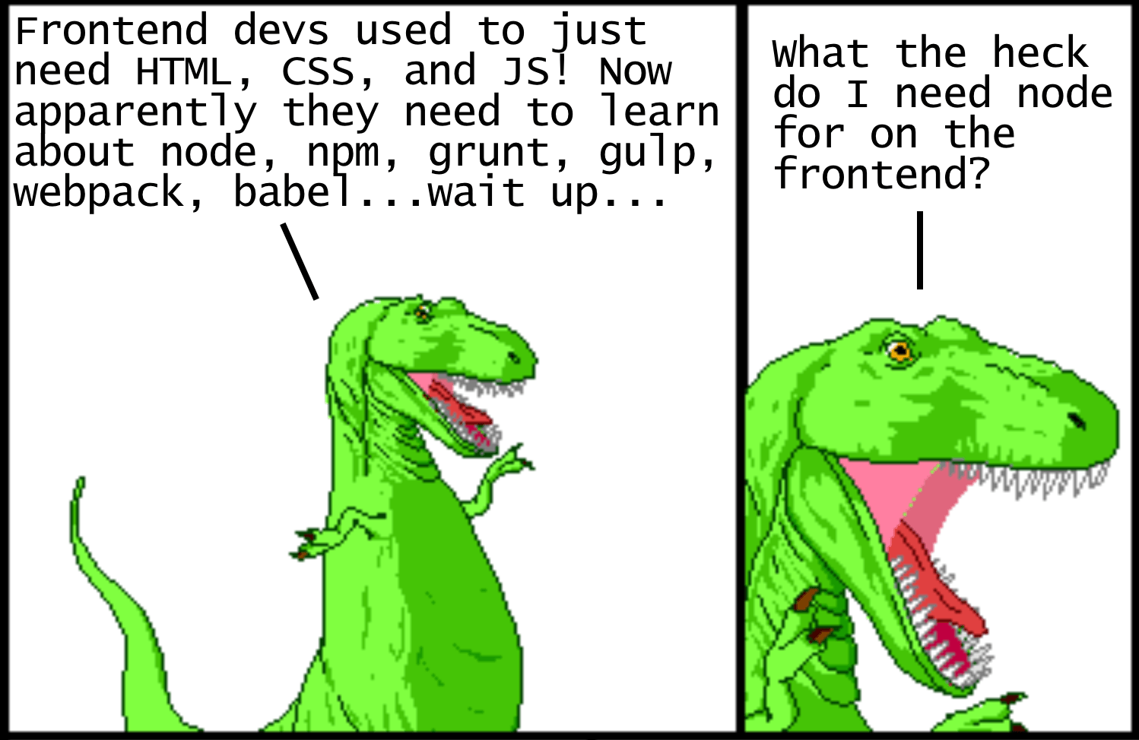
Say what now?
Node?
Package manager?
NPM?
$ npm init?
package.json?

Slide 15
Say what now? Come again?
Modern JavaScript Explained For Dinosaurs
https://medium.com/the-node-js-collection/modern-javascript-explained-for-dinosaurs-f695e9747b70

Slide 16
Step 4.1: Write some tests!
Write your tests first!
Then write functions that have the minimal code necessary to pass your tests.
We’ll use 3 really simple functions: add(), subtract(), and positiveOrNegative()

Slide 17
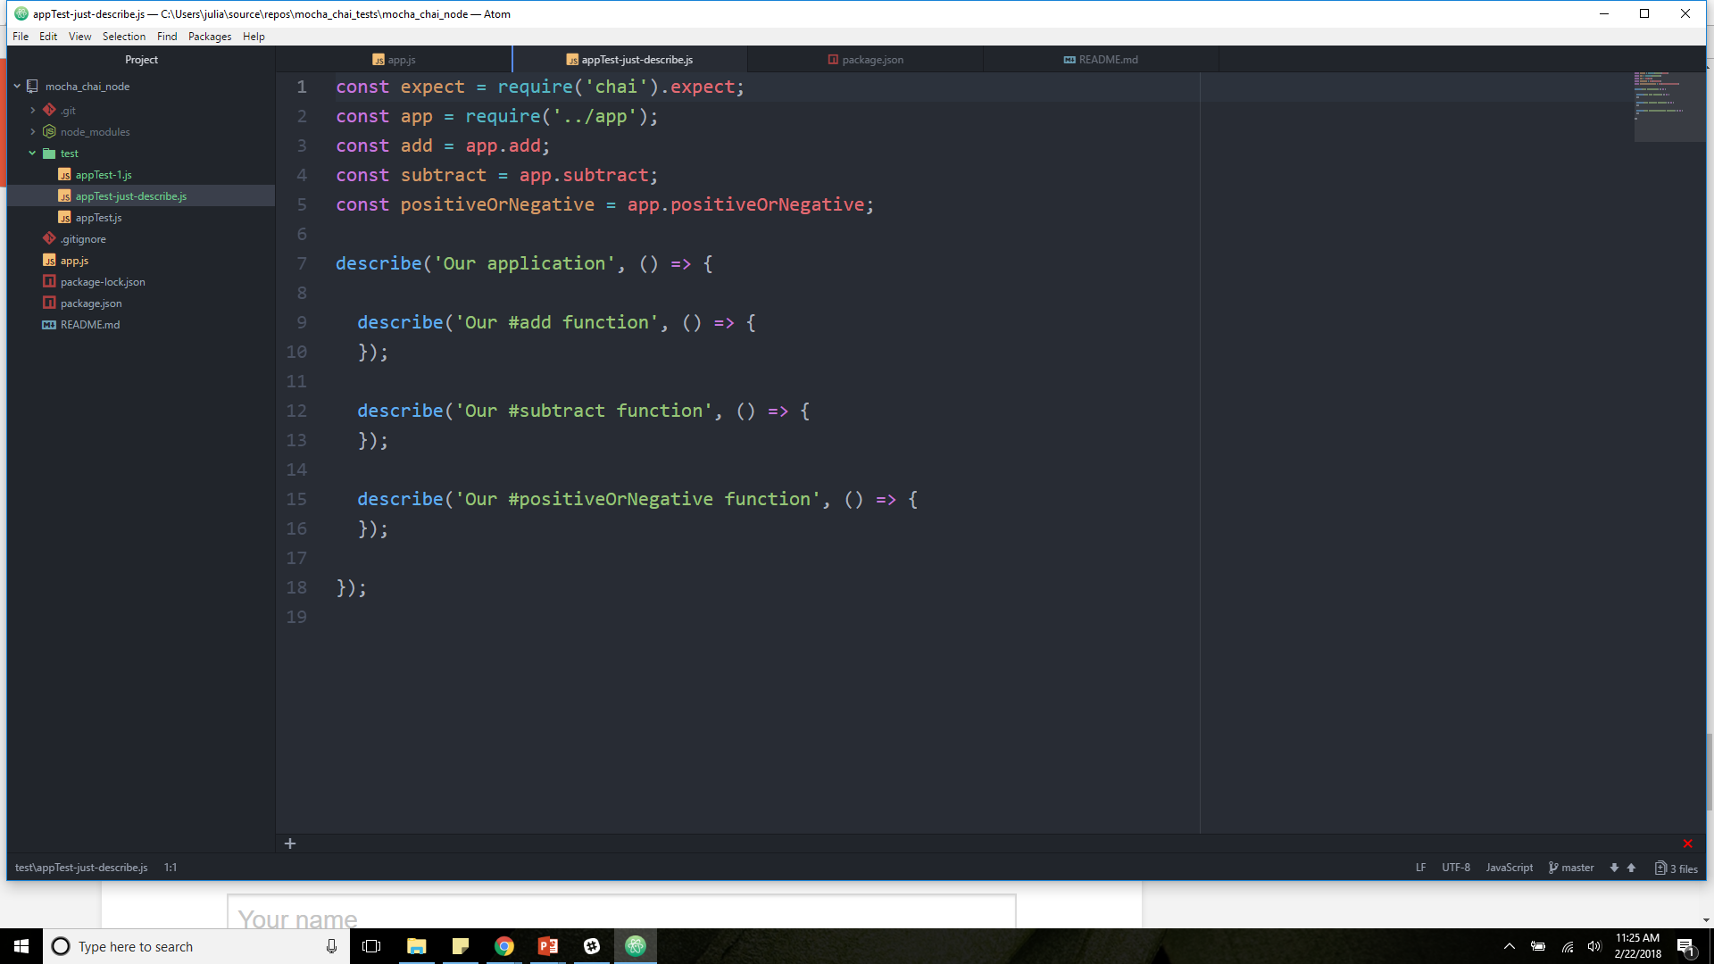
Step 4.2 (appTest.js)

Slide 18
Step 4.3 (appTest.js)

Slide 19
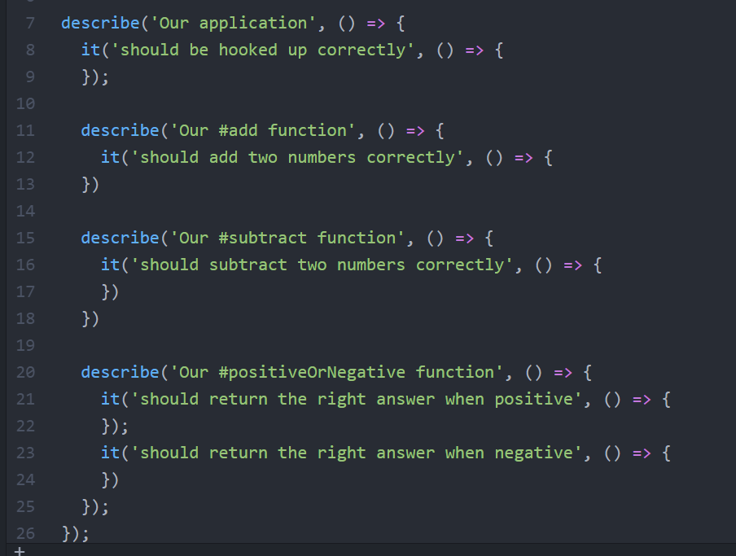
Step 4.4 (appTest.js)

Slide 20
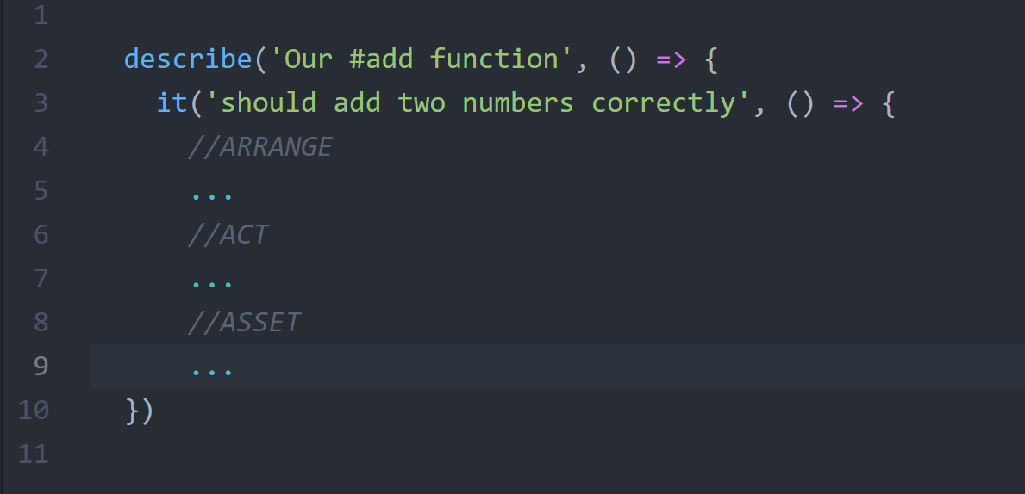
Step 4.4 (appTest.js)

Slide 21
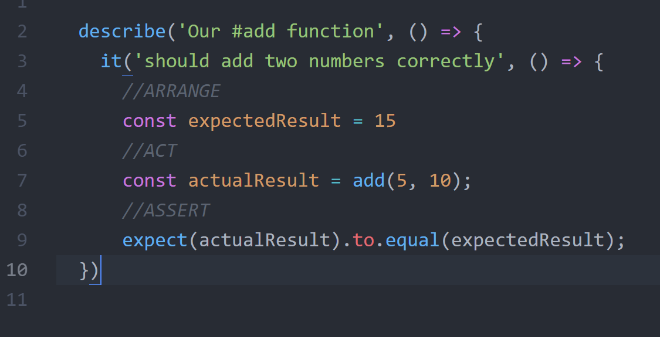
Step 4.5 (appTest.js)

Slide 22
Step 4.6
describe() is a way to group our tests in Mocha. We can nest our describes as deeply as necessary. describe() takes two arguments, the first is the name of the test group, and the second is a callback function.
it() is used for an individual test case. it() should be written as if you were saying it out loud: “It should equal zero”, “It should log the user in”, etc. it() takes two arguments, a string explaining what the test should do, and a callback function which contains our actual test
expect()

Slide 23
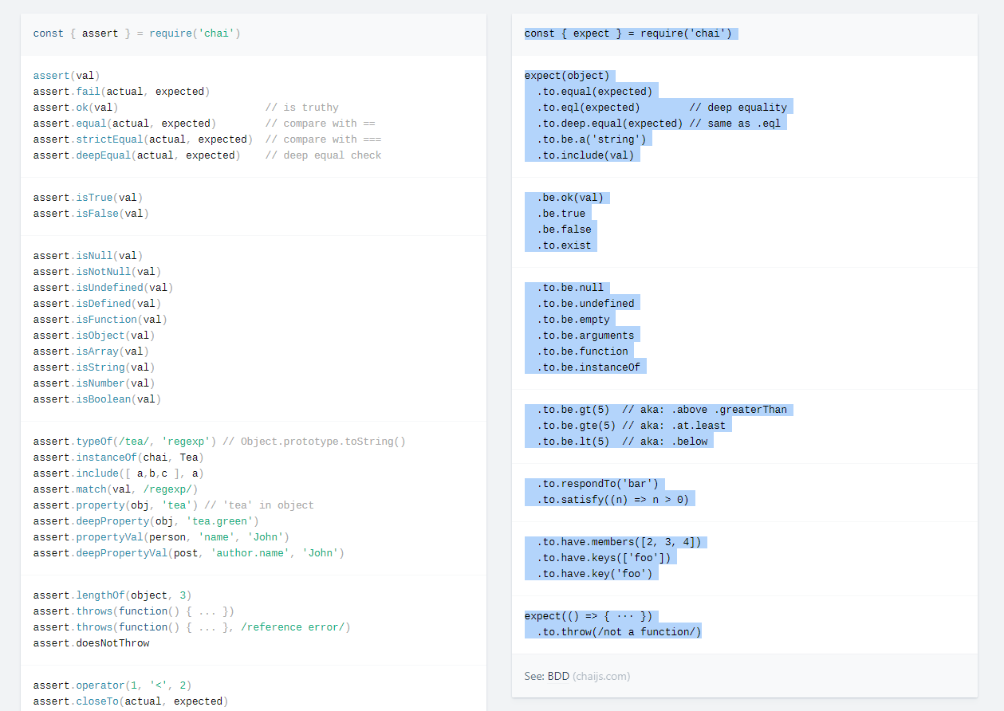

Slide 24
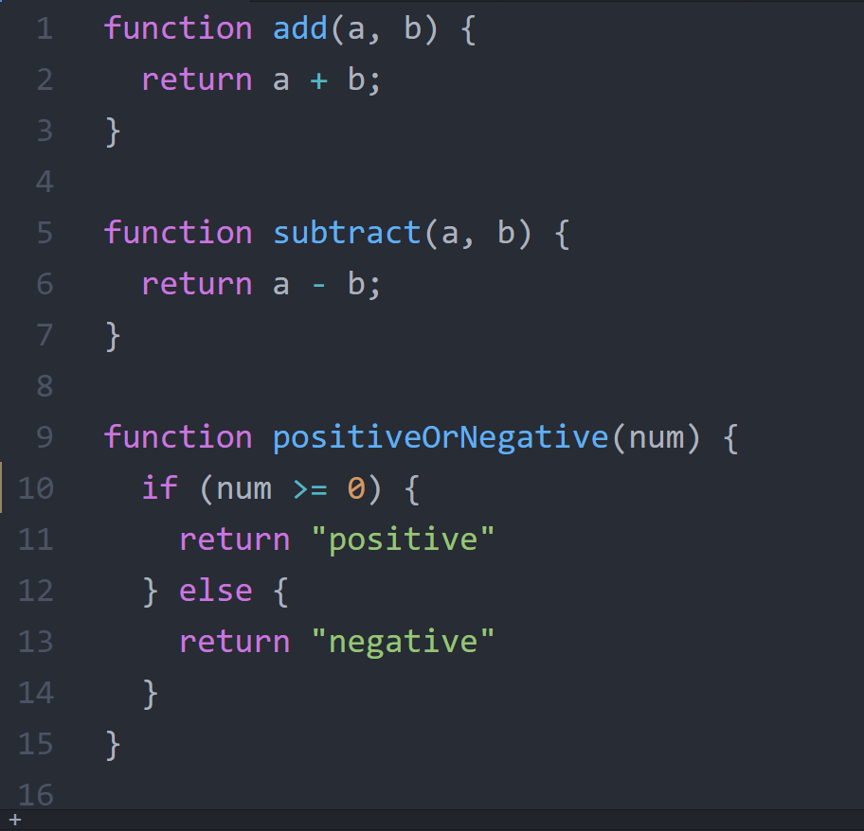
Step 5.1: Write our functions

Slide 25
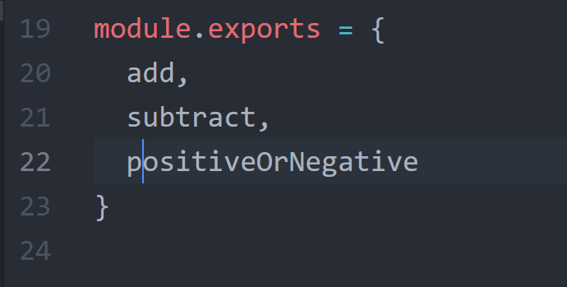
Step 5.2: Run our test

Slide 26
Step 6.1: Run our test
$ mocha

Slide 27
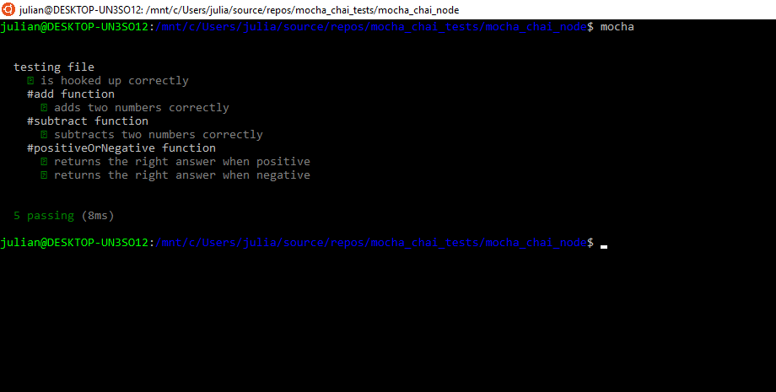
Step 6.2: Test Result

